Slide 1

1.6 The Computer Level Hierarchy
38
Computers consist of many things besides chips.
Before a computer can do anything worthwhile, it must also use software.
Writing complex programs requires a “divide and conquer” approach, where each program module solves a smaller problem.
Complex computer systems employ a similar technique through a series of virtual machine layers.

Slide 2
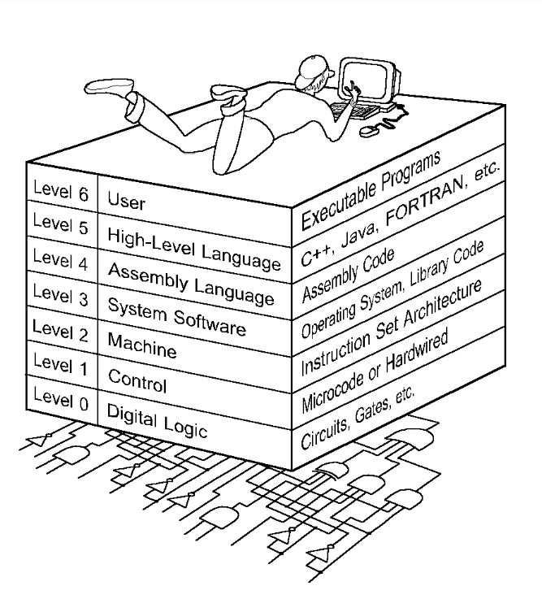
1.6 The Computer Level Hierarchy
39
Each virtual machine layer is an abstraction of the level below it.
The machines at each level execute their own particular instructions, calling upon machines at lower levels to perform tasks as required.
Computer circuits ultimately carry out the work.

Slide 3
1.6 The Computer Level Hierarchy
40
Level 6: The User Level
  Program execution and user interface level.
  The level with which we are most familiar.
Level 5: High-Level Language Level
  The level with which we interact when we write programs in languages such as C, Pascal, Lisp, and Java.

Slide 4
1.6 The Computer Level Hierarchy
41
Level 4: Assembly Language Level
  Acts upon assembly language produced from Level 5, as well as instructions programmed directly at this level.
Level 3: System Software Level
  Controls executing processes on the system.
  Protects system resources.
  Assembly language instructions often pass through Level 3 without modification.

Slide 5
1.6 The Computer Level Hierarchy
42
Level 2: Machine Level
  Also known as the Instruction Set Architecture (ISA) Level.
  Consists of instructions that are particular to the architecture of the machine.
  Programs written in machine language need no compilers, interpreters, or assemblers.

Slide 6
1.6 The Computer Level Hierarchy
43
Level 1: Control Level
  A control unit decodes and executes instructions and moves data through the system.
  Control units can be microprogrammed or hardwired.
  A microprogram is a program written in a low-level language that is implemented by the hardware.
  Hardwired control units consist of hardware that directly executes machine instructions.

Slide 7
1.6 The Computer Level Hierarchy
44
Level 0: Digital Logic Level
  This level is where we find digital circuits (the chips).
  Digital circuits consist of gates and wires.
  These components implement the mathematical logic of all other levels.

